Slide 1




STUDY TRACK AI BASED STUDENT STUDY HABIT RECOMMENDER
SUBMITTED BY
K BABY SRI KAVYA
JISMY C JOSEPH
ANAGHA VS
SNEHA ROSE C . J

Slide 2
ABSTRACT
The main objective of the AI Student Study Tracker System is to develop a web-based platform that enables students to record and monitor their daily study activities efficiently. The system aims to analyze study patterns using machine learning techniques and categorize students based on their performance and learning behavior. It focuses on providing clear visual insights through interactive dashboards and graphs to help students understand their progress. Additionally, the system helps identify strengths and areas that require improvement, encouraging better learning strategies. It also includes an admin module for managing datasets, monitoring system performance, and maintaining accuracy. Designed with a user-friendly interface, the project aims to simplify study tracking while promoting consistency, productivity, and improved academic outcomes.

Slide 3



PROBLEM STATMENT
LACK OF SELF-AWARENESS:
NO TRACKING SYSTEM:
NO DATA-DRIVEN INSIGHTS:
NEED FOR INTELLIGENT SOLUTION:
Students often struggle to understand their own study patterns and lack personalized guidance on how to improve their academic performance effectively.
Traditional education systems do not provide tools for tracking individual study habits, making it difficult to identify students who are falling behind or disengaged.
Without data-driven insights, teachers and administrators are unable to take timely action to support students based on their actual behavior and performance patterns.
There is a growing need for an intelligent system that can automatically analyze student data, group them based on similar behavior, and deliver targeted recommendations to help each student reach their full potential.

Slide 4

SYSTEM DEVELOPMENT:
To build an AI-powered web application that tracks student study behavior and uses KMeans clustering to group students based on their academic performance patterns. The system aims to bridge the gap between raw student data and actionable insights by automating the analysis process and delivering results through an interactive web interface.
OBJECTIVE
STUDENT EMPOWERMENT:
To provide each student with personalized study recommendations, optimal study schedules, and progress tracking tools based on their assigned cluster group. Students can also log their daily study sessions and monitor their own improvement over time through visual charts and performance summaries.
ADMIN CONTROL & INSIGHTS:
To give administrators a powerful dashboard to monitor student activity, manage datasets, and retrain the clustering model in real time. Admins can gain data-driven insights into overall student performance, identify struggling groups, and take timely action to improve academic outcomes across the institution.

Slide 5


TECH STACK
Frontend & UI
Streamlit — used to build the entire web application interface and navigation
Machine Learning
Scikit-learn — KMeans Clustering for student grouping
Scikit-learn — StandardScaler for data normalization
Data Processing
Pandas — data manipulation and CSV file handling
NumPy — numerical computations and array operations
Visualization
Plotly Express — interactive charts like scatter plots, line charts and bar charts
Plotly Graph Objects — advanced charts like radar charts and donut pie charts
Authentication & Security
Hashlib SHA-256 — secure password hashing for login system
JSON — storing user credentials and cluster configuration
Data Storage
CSV Files — storing student dataset and study session logs
JSON Files — storing registered users and cluster config

Slide 6
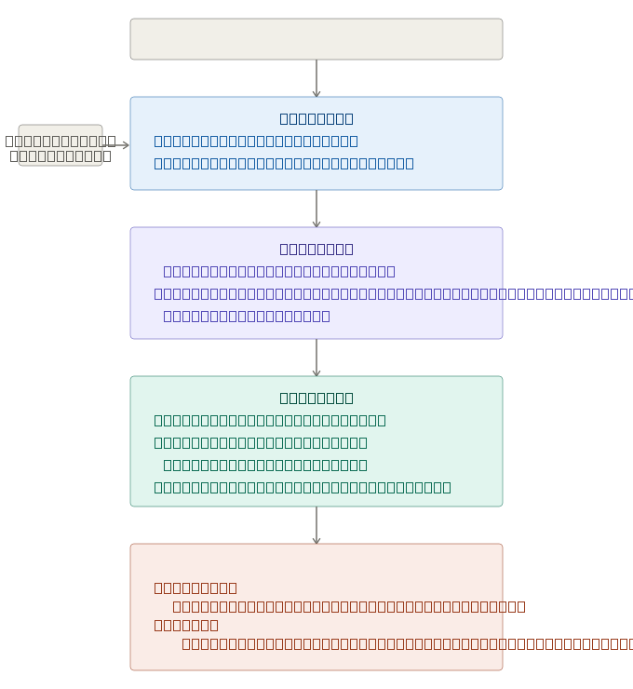
SYSTEM ARCHITECURE
The system architecture of the AI Student Study Tracker System shows how data flows between users, the application, and the database. Students enter their study session details through the web interface, which are stored and processed by the system. Machine learning algorithms analyze this data to identify study patterns and categorize performance. The results are displayed through interactive dashboards for easy understanding. The admin module manages data, monitors system activity, and updates the model, ensuring smooth and efficient functioning of the system.
"Modules are divided based on development scope. After login, students are directed to Module 3 and Module 4, and admins are directed to Module 1 and Module 2 based on their role."

Slide 7
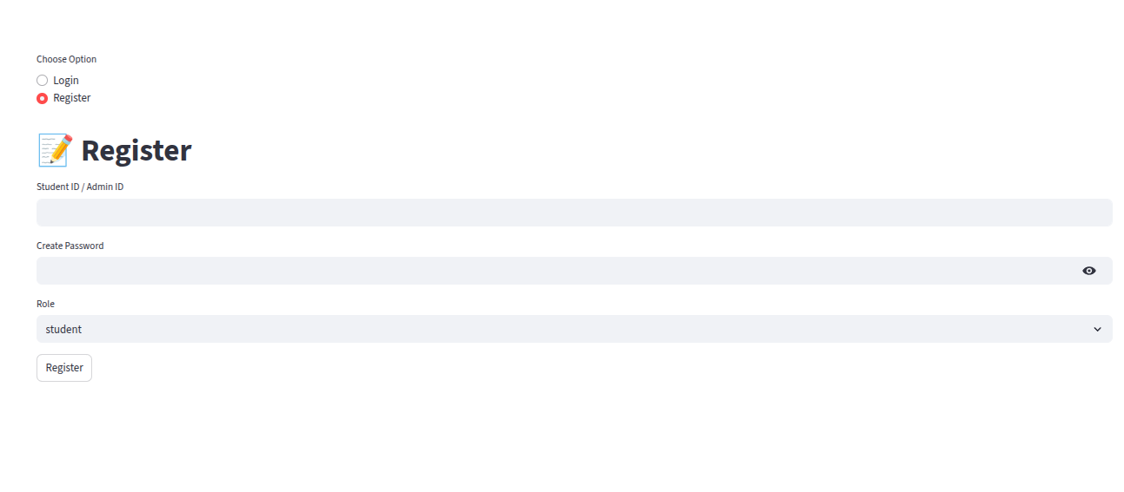
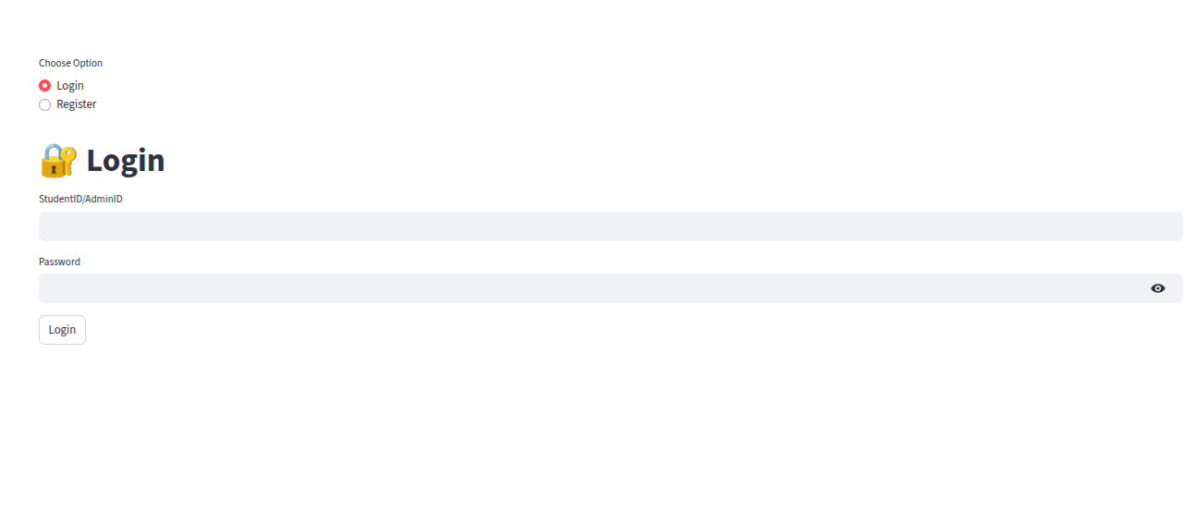
MODULES
AUTHENTICATION MODULE:
Role-based login — Student and Admin
SHA-256 password hashing for security
Student registration validates ID against dataset
Admin can register with any ID
Session state maintains login across pages

Slide 8
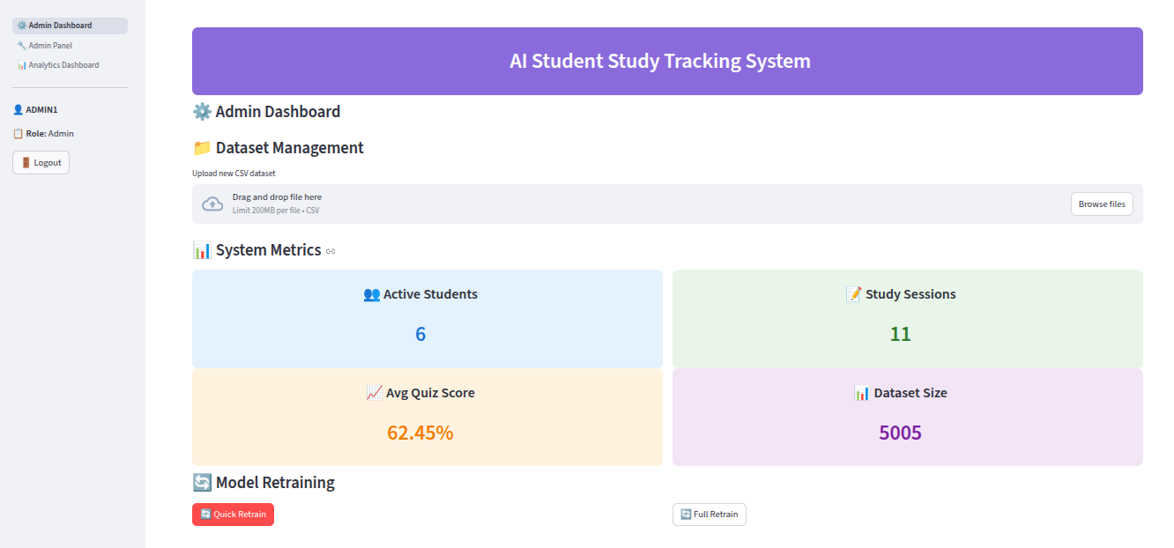
ADMIN DASHBOARD:
System metrics:
Active Students
Total Study Sessions
Average Quiz Score
Dataset Size
Dataset upload — replace CSV with new data
Quick Retrain — uses student logs for retraining
Full Retrain — uses full dataset features

Slide 9
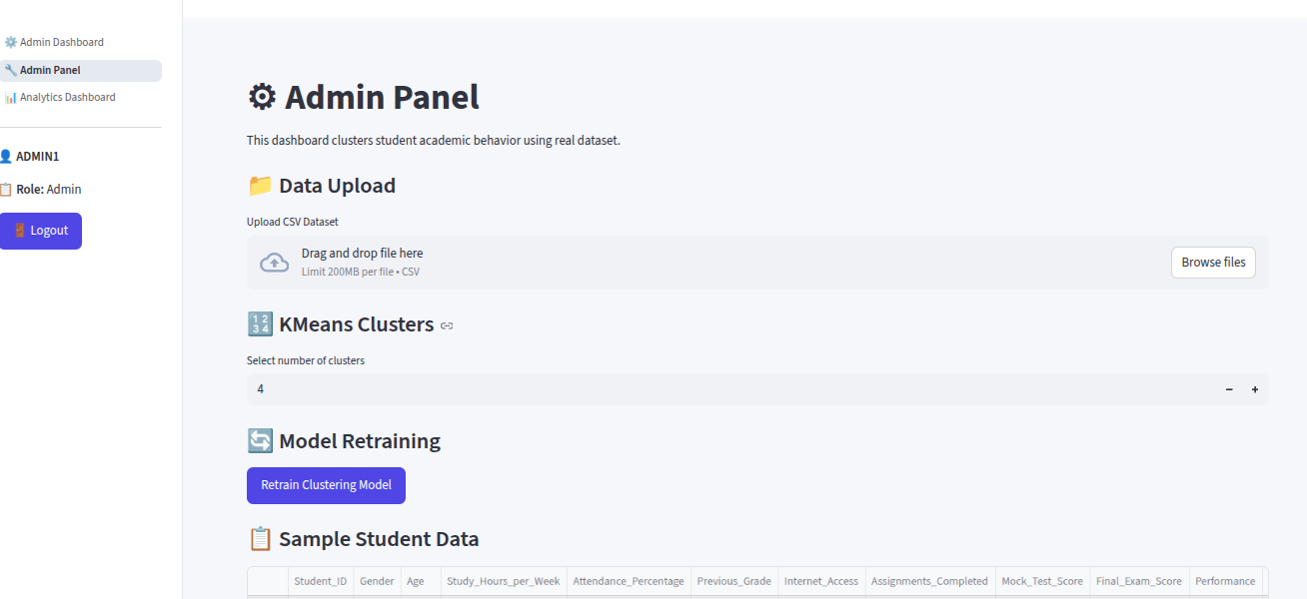
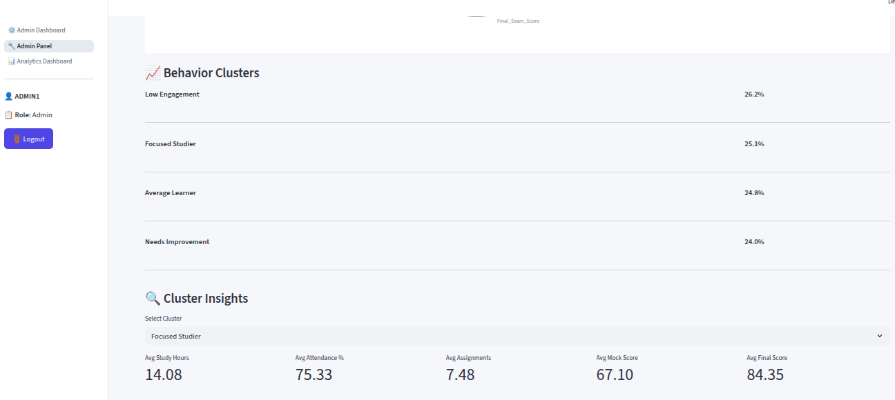
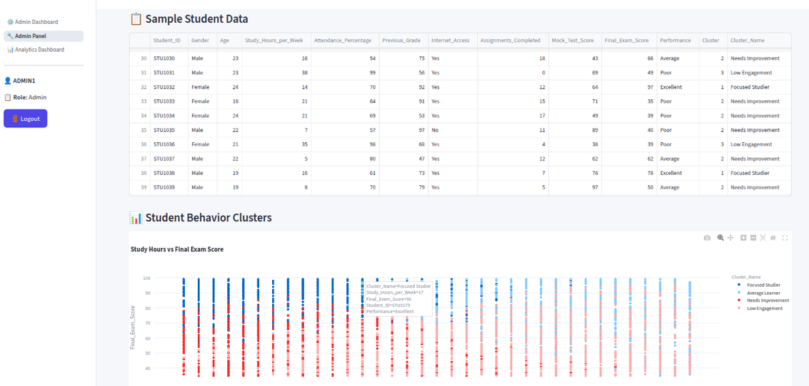
ADMIN PANEL:
KMeans clustering with configurable number of clusters
Sample student data table
Scatter plot — Study Hours vs Final Exam Score
Radar chart — Cluster characteristics comparison
Cluster percentage breakdown
Cluster insights — avg metrics per cluster
Add new student with automatic cluster assignment

Slide 10
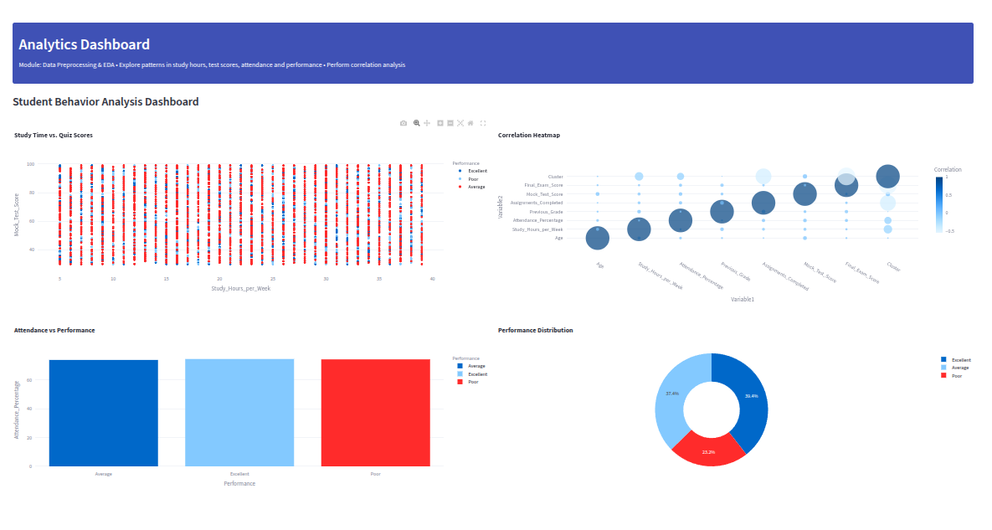
ANALYTICS DASHBOARD:
Study Time vs Quiz Scores — Scatter Plot: This graph shows the relationship between the amount of time a student studies and their quiz scores, helping to identify whether increased study time leads to better performance.
Correlation Heatmap — Bubble Chart: This visualization highlights the strength of relationships between different variables like study time, attendance, and scores, making it easy to spot strong or weak correlations.
Attendance vs Performance — Bar Chart: This chart compares students’ attendance levels with their performance, showing how regular attendance impacts academic results.
Performance Distribution — Donut Pie Chart: This chart represents the proportion of students in different performance categories, such as high, medium, and low performers, giving an overall view of class performance.

Slide 11
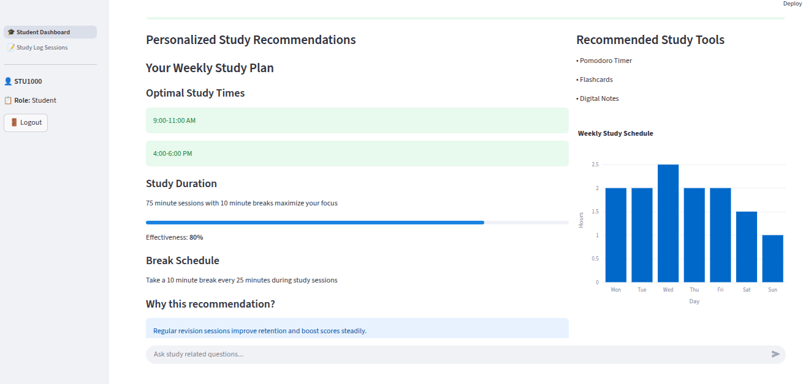
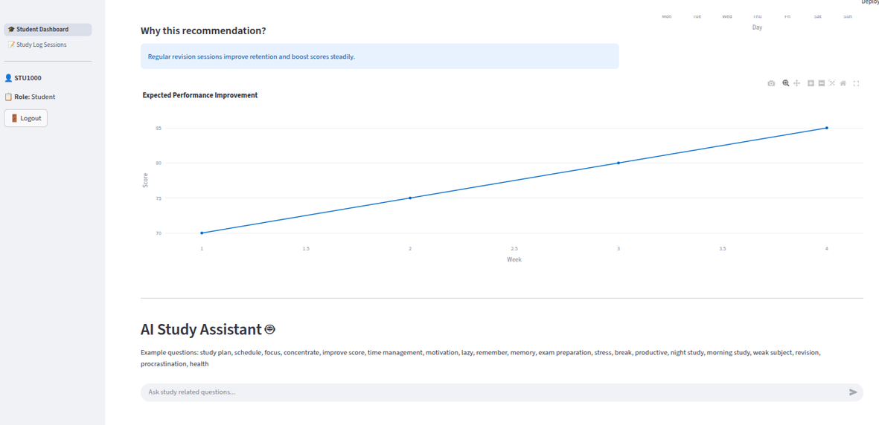
STUDENT DASHBOARD:
Auto-loads logged-in student's data using session state
Displays cluster group and label
Personalized recommendations:
Optimal study times
Session duration and break schedule
Recommended study tools
Weekly study schedule chart
Expected performance improvement chart
AI STUDY ASSISTANT CHATBOT:
Rule-based chatbot for study-related queries
Topics covered:
Study plan, time management, focus
Exam preparation, motivation, memory
Stress management, revision, health
Chat history maintained during session

Slide 12
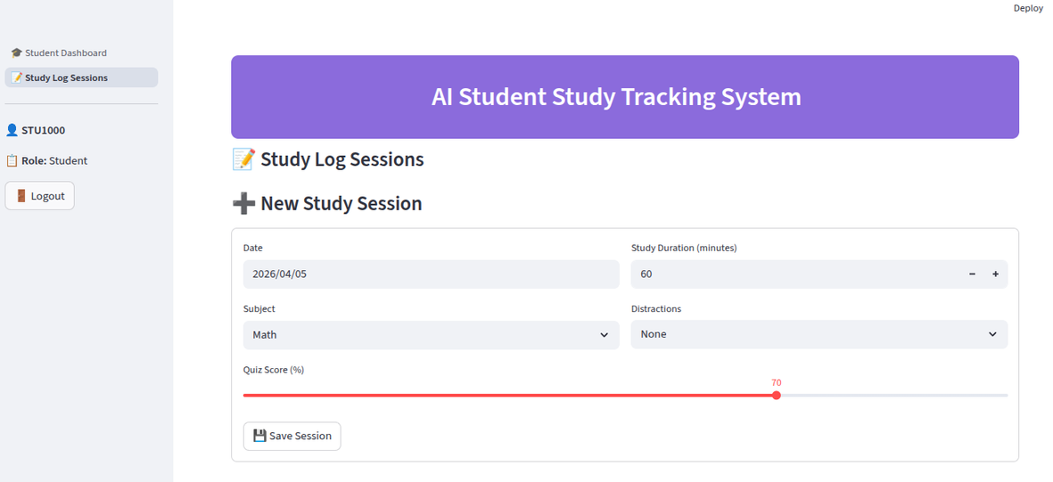
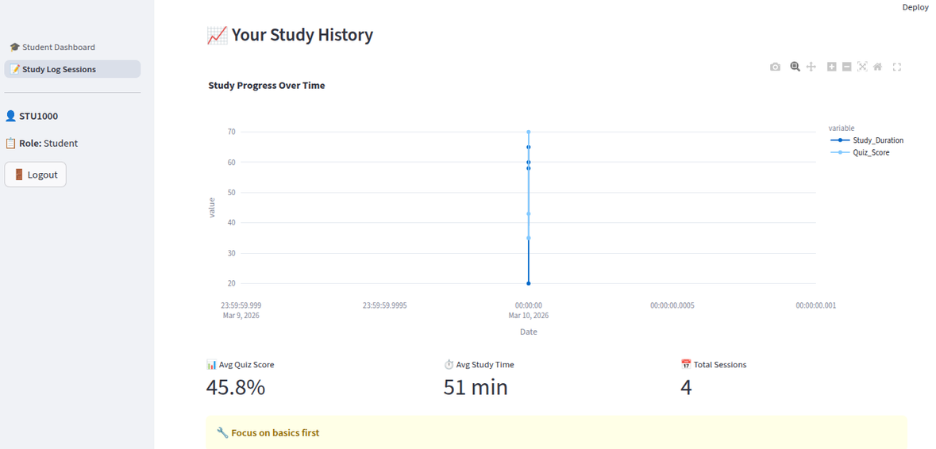
STUDY LOG SESSIONS:
Students log daily study sessions
Fields: Date, Subject, Duration, Distractions, Quiz Score
Data saved to student_logs.csv
Progress visualization — line chart over time
Performance summary — avg score, avg study time, total sessions
Smart recommendations based on avg quiz score

Slide 13
RESULT ANALYSIS
The results of the AI Student Study Tracker System demonstrate that consistent study habits and higher attendance are directly associated with better academic performance. The scatter plot indicates a positive relationship between study time and quiz scores, showing that students who invest more time in studying tend to achieve higher marks. The correlation analysis further confirms strong links between key factors such as study time, attendance, and performance. Additionally, the bar chart highlights that students with regular attendance perform significantly better than those with irregular participation. The performance distribution chart shows a balanced spread of students across different categories, while also identifying areas where improvement is needed. Overall, the system effectively provides meaningful insights that help students and administrators make informed decisions to enhance learning outcomes.

Slide 14
CONCLUSION
Successfully clustered 5000+ students into meaningful groups ranging from Needs Improvement to Elite Performer using KMeans clustering.
Each student received a personalized study plan with optimal study times, session duration and recommended tools based on their cluster group.
Admins gained complete visibility into student behavior through interactive scatter plots, radar charts and cluster percentage breakdowns.
Students were able to log daily study sessions, track their progress over time and get instant guidance from the AI study assistant chatbot

Slide 15
FUTURE SCOPE
The rule-based chatbot can be upgraded to an LLM powered AI assistant that understands natural language and provides more accurate and conversational study guidance.
Automated email or SMS alerts can be integrated to notify students, parents and admins when a student's performance drops below a set threshold.
The system can be connected to real college databases to automatically sync student records, attendance and exam scores, eliminating manual CSV uploads.
A dedicated parent login module can be introduced to give parents real-time visibility into their child's study sessions, cluster group and overall academic progress.
The clustering model can be strengthened by exploring advanced algorithms like DBSCAN or Hierarchical Clustering to better handle complex student behavior patterns.
A mobile friendly version can be developed and deployed on Streamlit Cloud, making the system accessible to students and admins from any device at any time.

Slide 16
THANK YOU
STUDY TRACK AI BASED STUDENT STUDY HABIT RECOMMENDER

